Slide 1

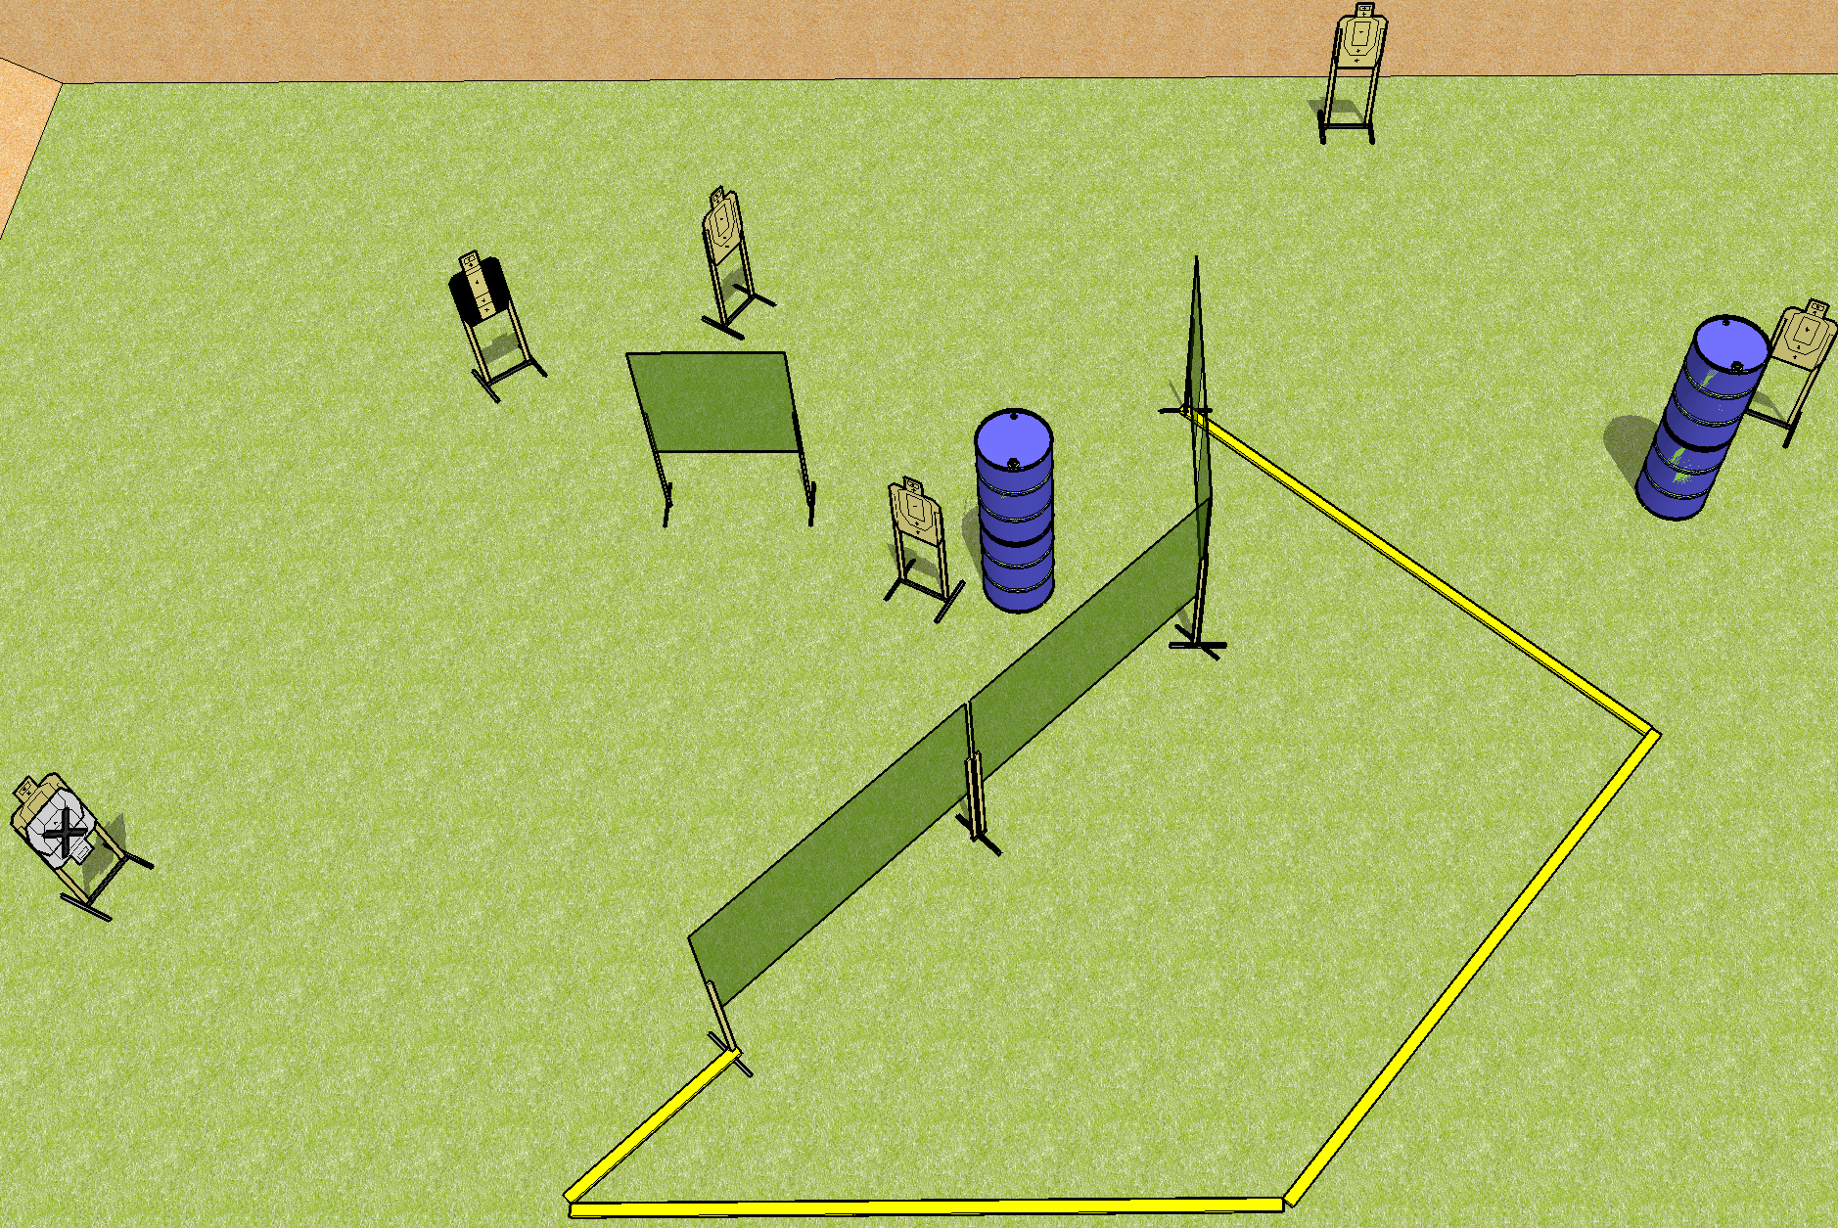
 | Dothan Practical Shooters – USPSA Match Short Shorts Course Designer : Drew Coleman Bay: B3
Round Count 12 rounds 6 USPSA
Equipment List 7 wall feet 6 targets (5 + 1 NS) 1 tux

Slide 2
Short Shorts
Written Stage Briefing
Scoring: Comstock Rounds: 12
Targets: 6 USPSA
Handgun start position: anywhere completely outside the shooting area, wrists below belt. Handgun is loaded and holstered.
PCC start position: anywhere completely outside the shooting area, stock on belt. Loaded carbine is held with both hands, safety on.
Stage Procedure: on the audible start signal, engage targets as they become available from within the shooting area.

